Slide 1
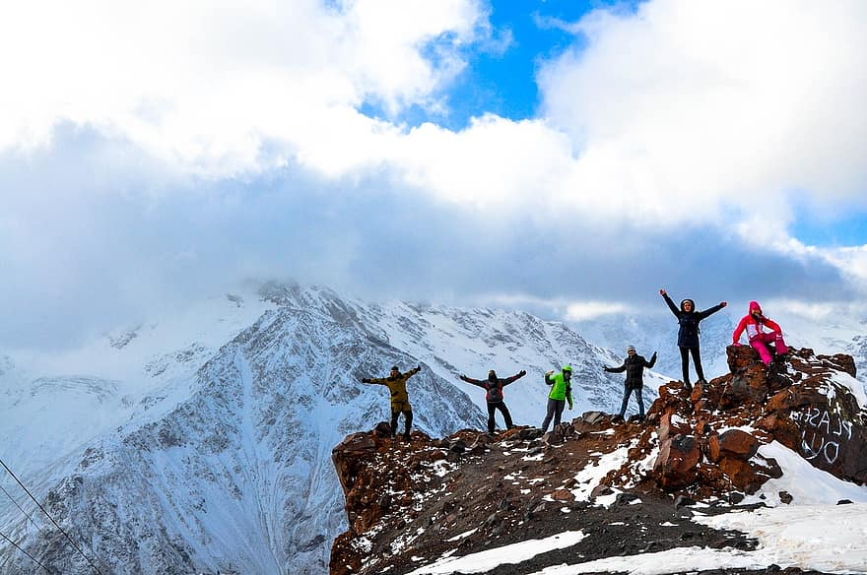
The
Outlanders
Backgrounds taken from https://www.googleimagesearch.com/

Slide 2
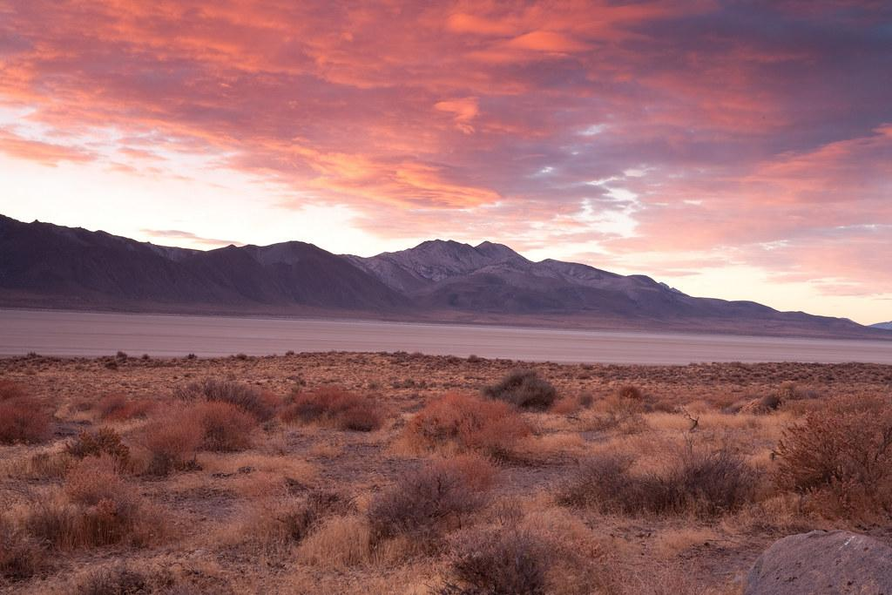

The Outlanders Team
Team Members:
Chris Beatty
Brian Gossett
Larissa Passamani Lima
Christeen Safar
Michele Speidel
Module 11.2 Assignment
Milestone #4
CSD310-330H_2225_DD
Database Development and Use
Date: July 17, 2022
Backgrounds taken from https://www.googleimagesearch.com/

Slide 3



The Outlanders - Group Introduction
The Outlanders was formed on July 4, 2022, to handle Case Study for Outland Adventures. Our team is made of five eager students in the 330H Cohort Software Development Program at Bellevue University instructed by Profession Sampson and Professor Woods.
Chris Beatty
has experience in database development. He also spends his time automating file storage and media on his home server.
Brian Gossett
was a programmer in the military in web development. He is working on a degree here for his resume in the hopes of working for FAANG.
Photos taken from https://www.123rf.com/photo_15063120_boy-hiking-illustration.html
Photos taken from https://www.lovepik.com/

Slide 4



Michele Speidel
is an insurance professional and has experience in database development. She currently works in a remote position as a Business Analyst.
Larissa Passamani Lima
is fairly new to database development. She has a degree in Criminal Justice, and experience in Supply Chain Operations. She is currently working as a Wave Technician for a Flow Center.
Christeen Safar
has no experience in database development. She has two Bachelor's degrees in Child Development. Now, she works as a Personal Stylist at Macy’s, but she is planning to work in her new major.
Photos taken from https://www.kissclipart.com/skier-cartoon-hiking-equipment-trekking-pole-ski-tj9g9b
Photos taken from https://www.vectorstock.com/

Slide 5
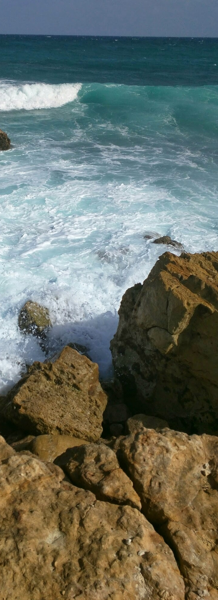

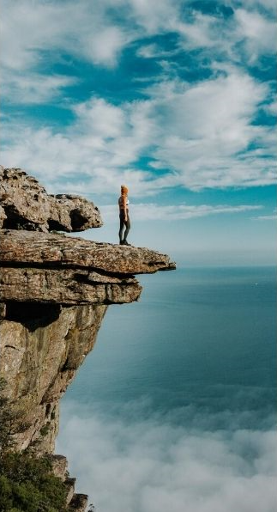
Outland Adventures
Cast Study Selected
Photos taken from https://ibelieve.com/
Photos taken from https://ibelieve.com/
Photos taken from https://www.wanderlustmovement.org/

Slide 6
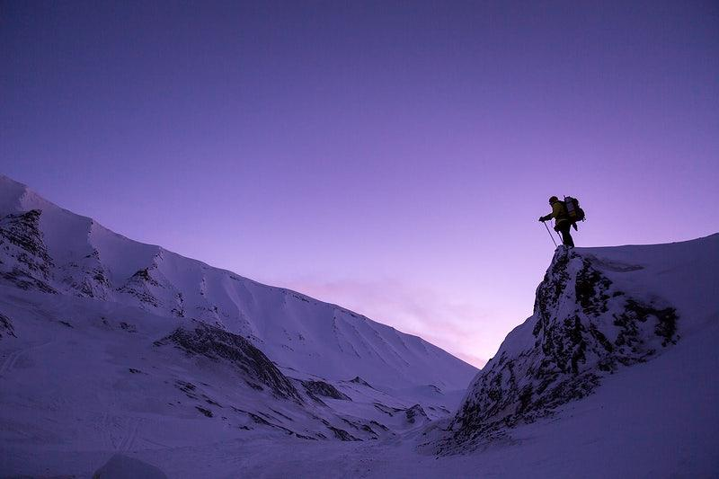
A Brief Description of Case Study
Mission
To provide adventurous guided trips for the hiking and camping enthusiasts
Description of Case Study
Outland Adventures was founded back in January 1, 2022 when Blythe Timmerson and Jim Ford decided to take a risk and dedicate their time and energy into the vision of what would become Outland Adventures. Their primary focus of the company was to share their passion with others.
The reason Outland Adventures has been thriving is because the organization focuses on providing the best quality experience with well informative guided tours, safety precautions, and adventure to far off places with great destinations that have been fully experienced priorly in order for the guides to offer the most well crafted excursions. Choosing the “Right Adventure” is the primary focus of the company to continue improving the experience provided to its customers.
Mission of success:
Focusing on customers
Employing a great management team
Keeping detailed financial records
Continuing to innovate
Pursuing long-term goals
Adapting to new technology
Backgrounds taken from https://www.googleimagesearch.com/

Slide 7
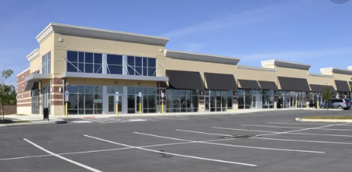
Location of the Store
The store is located at 2309 Iowa Center Rd, Neverland IA 09989. The location allows customers to purchase the necessary equipment for their trip as well as providing information about their excursions to customers in person.
Photos taken from https://www.istockphoto.com/search/store

Slide 8
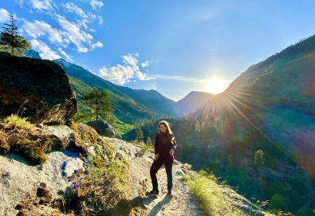
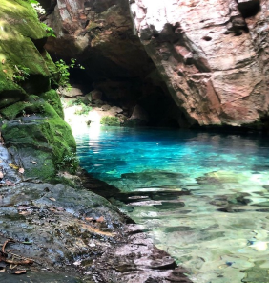
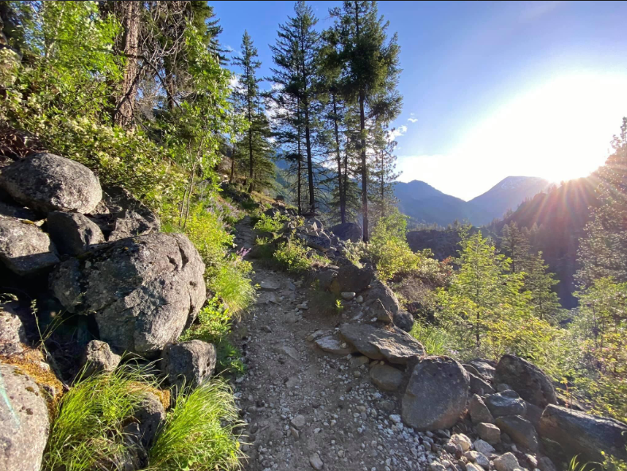
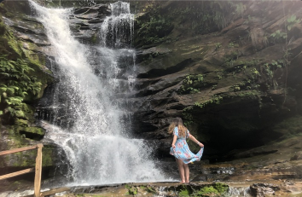
Adventure to Far Off Places
Photos taken by Larissa Passamani in Washington state and Brazil
The idea of creating the “Outland Adventure” project was to find great destinations for curious travelers who are eager to discover new realms. These destinations are the world's best places to travel to; according to the experts. The locations where they have conducted treks are Africa, Asia, Northern Europe, Southern Europe, North America. The founders of Outland Adventure were planning to arrange guided trips to the world's most wondrous places to create the best travel experience for their customers.

Slide 9
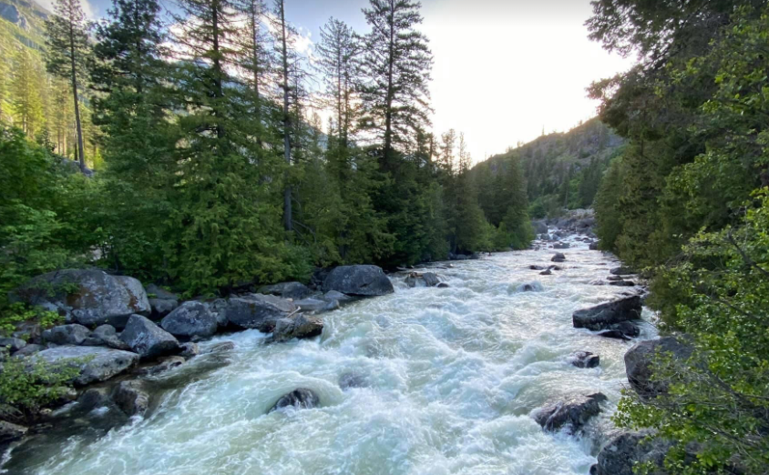
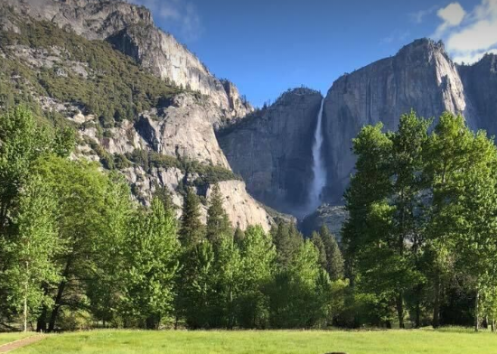
The “Right Adventures”
Outland Adventures was designed to offer great destination guided tours. The company has taken the time and efforts to get to know the places before adding them to their destination guides in order to provide unique experiences that cannot be found with any other guided organization. They have spent many months crafting excursions to different regions of the world. These regions have been purposely picked to be different from one another in order to provide a unique experience that cannot be repeated in another trip.
Photos taken by Larissa Passamani in Washington state and Yosemite

Slide 10
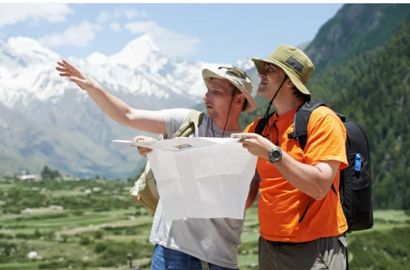
Behind the Organization
Owners
Blythe Timmerson and Jim Ford are the owners and CEOs of Outland Adventures.
They both share the passion for the outdoors, and continually devote their full time and energy into their joint venture.
Photo taken from https://depositphotos.com/stock-photos/tourist-guide.html

Slide 11


Tour Guides
With 25 years of combined tour guiding experience, John ‘Mac’ MacNell, and D.B. ‘Duke’ Marland are the tour guides for every excursion.
They are also in charge of organizing and planning the trips, including investigating airfares, visa requirements, and inoculations.
Photos taken from https://www.istockphoto.com/search/2/image?phrase=tourist+guide

Slide 12



Mei Wong has 10 years of experience in building excellent E-Commerce websites. She was just recently hired by Outland Aventures to build an E-Commerce site for the organization, to allow potential customers the ability to find out about trip schedules, types of excursions, and purchase or rent hiking and camping equipment in advance.
Support Team
Anita Gallegos has 15 years of experience as a Marketing Analyst and is in charge of all of the marketing aspects of the organization.
Dimitrios Stravopolous has 7 years of experience managing inventory. He was hired to be in charge of ordering supplies for the trips as well as keeping the equipment inventory up to date.
Photos taken from https://www.istockphoto.com/search

Slide 13
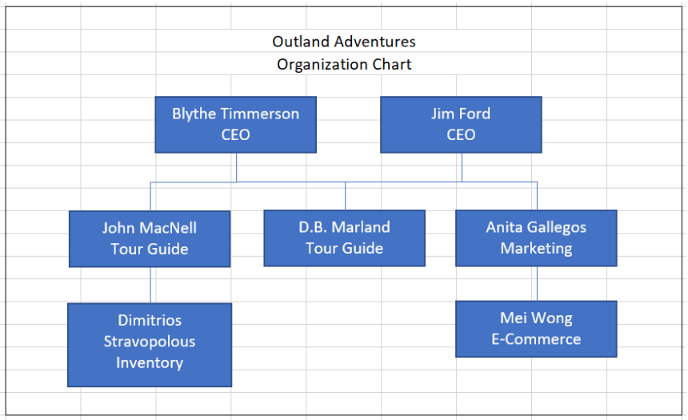
Organization Chart

Slide 14
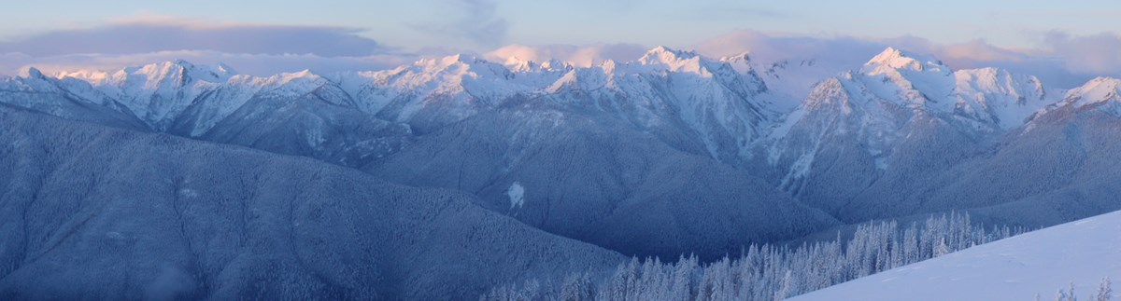
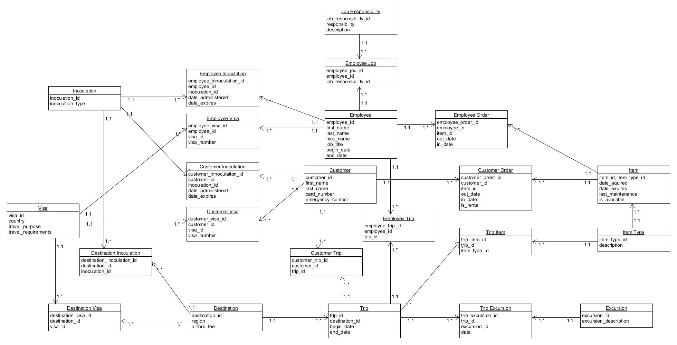
The Group ORD

Slide 15

Three Key Organization Optimization Reports
Regional Total Trips, Regional Total Customers Report & Trip Region Total Customer
Are there downward booking trends in any of the Regions (primarily Africa, Asia, and Southern Europe)
Customer Buy & Customer Rent vs Buy Report
Do enough customers buy equipment to keep equipment sales
Item By Age Report
Are there inventory items that are over five years old (items will need to be replaced)

Slide 16
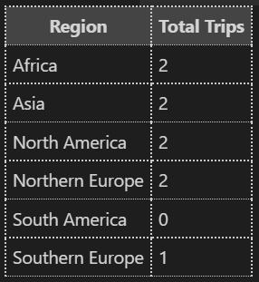
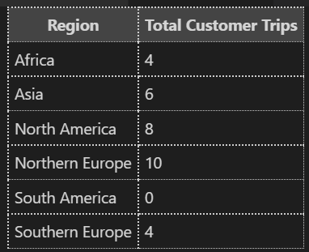
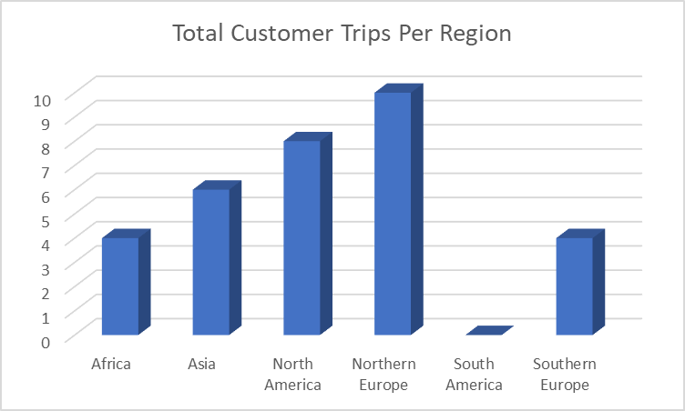
Regional Trip & Customer Reports
Total Trips
This report shows number of trips scheduled for each region
There are two trips scheduled in four regions and less than two in the other regions
Total Customer Trips
This report shows how many customers have selected trips in each region.
Asia, North America, and Northern Europe have six or more customers scheduled per region and have been substantial to the optimization plan.
Southern Europe has four trip customers for only one trip. Marketing efforts will focus on this trip to increase customer interest and bookings.
Although Africa also has four trip customers, it is spread out between two trips and does not support optimization. Due to the lack of interest in this region and zero interest in South America, these two regional will be removed from the marketing plans and the schedule.

Slide 17

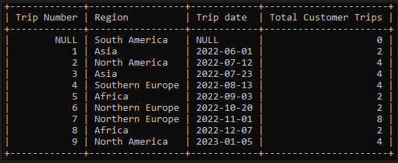
Trip Region Total Customer
Trip Region Total Customer
This Report elaborates further on the trip trends. It shows each trip region, the trip dates, and total customers per trip.
Upward Trend
Asia 2-trips; 6-customer
North America; 2-trips; 8-customer
Northern Europe; 2-trips; 10-customer
Moderate Trend
Southern Europe; 1-trip; 4-customers
Downward Trend
Africa; 2-trips; 4-customers
South America; 0-trips; 0 customers

Slide 18
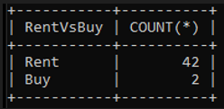
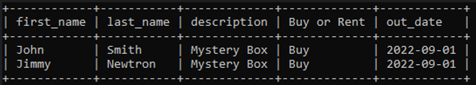
Equipment Sales Reports
Customer Rent vs Buy
This report shows the quantity of equipment purchased rather than rented. Forty-Two items were rented but only two were purchased.
Customer Buy Report
This report shows the type of equipment being
purchased. It includes the customer’s name, and
the date purchased (the “out_date”).
Equipment sales are not substantial to the optimization plan so general equipment sales will be discontinued.
However, the Mystery Box will be added to the marketing efforts to help increase sales.

Slide 19
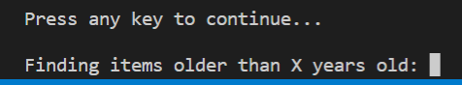
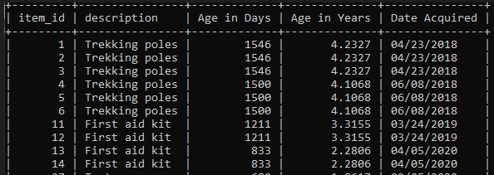
Item By Age Report
Item By Age Report
This report provides inventory details, description of item, age in days, age in years, and date acquired.
An interactive report is used to identify the equipment with an age greater than the age entered (this report shows equipment > 2-years old for example)..
No equipment is over five years old at this time but there are some Trekking poles the CEOs added to the inventory that will reach the 5-year old mark and will require replacement within the year.

Slide 20

Other Key Reports for Case Study
Equipment Needed Per Trip
This report provides the equipment needed by region.
Customer Visa And Shot Records
These reports provide inoculation and visa details for each customer for the regions and dates they plan to travel.
Employee Visa And Shot Records
These reports provide inoculation and visa details for each employee for the regions and dates they plan to travel.
Trip Schedule
The company needs a report so potential customers can check on trip schedules

Slide 21

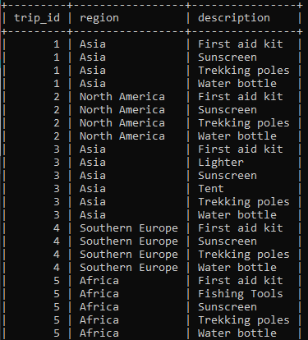
Equipment Needed Per Trip Report
Trip Equipment
Equipment Needed Per Trip Report
This report provides the equipment needed by region.
Tour Guides and Customers will need to know what equipment is required per Trip so they can prepare to rent or buy equipment.
Inventory staff needs reports for trip inventory to identify what equipment is needed.
Backgrounds taken from https://www.googleimagesearch.com/

Slide 22

Customer & Employee Visa And Shot Records
Purpose of Reports
These reports provide inoculation and visa details for each customer or employee for the regions and dates they plan to travel.
Administration and Guides need these reports to determine inoculation and visa compliance
Backgrounds taken from https://www.googleimagesearch.com/

Slide 23
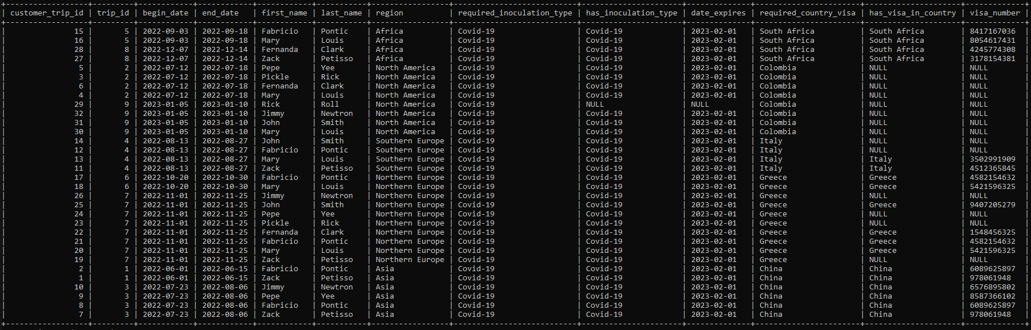
Customer Visa And Shot Records
The report shows that all countries require customers to get inoculation type for COVID-19.
Most countries will require customers to get a Visa. For the “NULL” in the “has_inoculcation_type”, “date_expires”, “visa_number” or “has_visa_in_country”, the guides will have to quickly gather information to notify the customer(s) of the requirements before the trip.
Backgrounds taken from https://www.googleimagesearch.com/

Slide 24
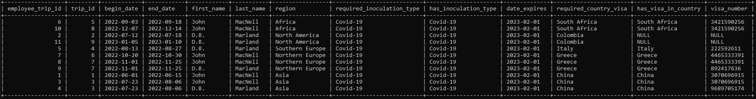
Employee Visa And Shot Records
The report shows that all countries require employees to get inoculation type for COVID-19.
Most countries will require employees to get a Visa. However, for the “NULL” in the “visa_number” or “has_visa_in_country”, the Administration will have to quickly gather that information and notify the appropriate employee(s) of the requirements before the trip.
Backgrounds taken from https://www.googleimagesearch.com/

Slide 25

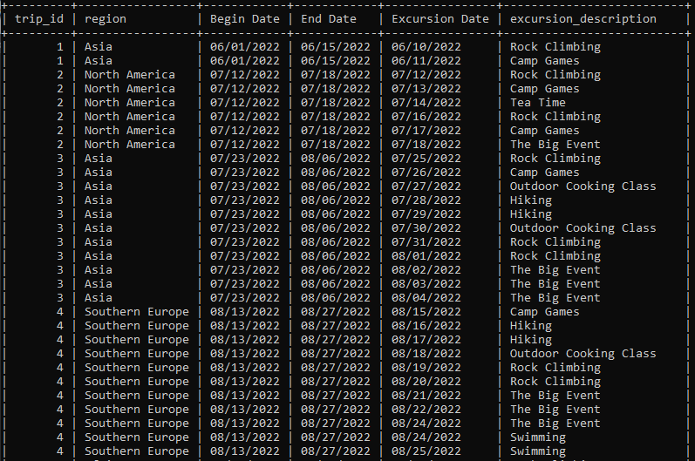
Trip Schedules
Purpose of Report
This report is needed so customers and staff can check on trip schedules and each day’s excursion.
The report shows trip_id, region, and each excursion with the beginning and ending date of the trip (for example; trip_id 1 is one trip to Asia with two different excursion)

Slide 26
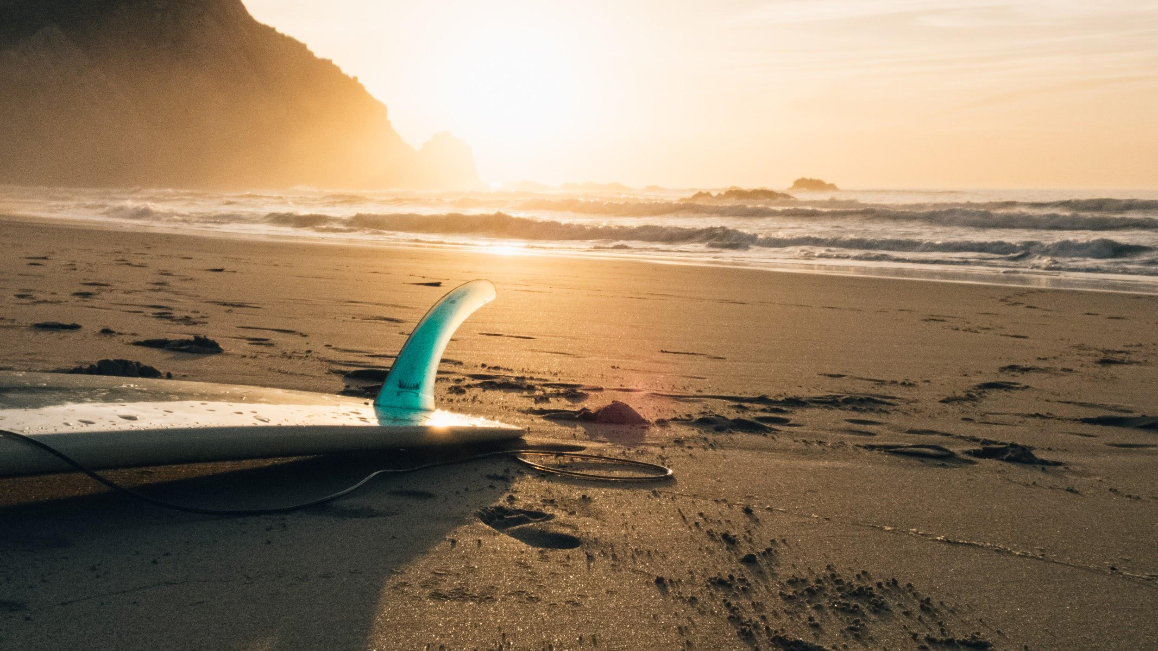
Destinations
Photos taken from https://pinterest.com/

Slide 27
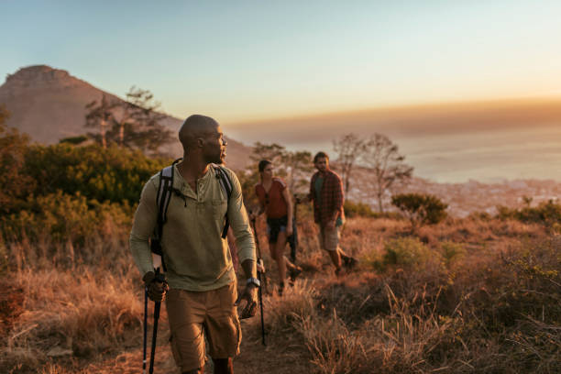
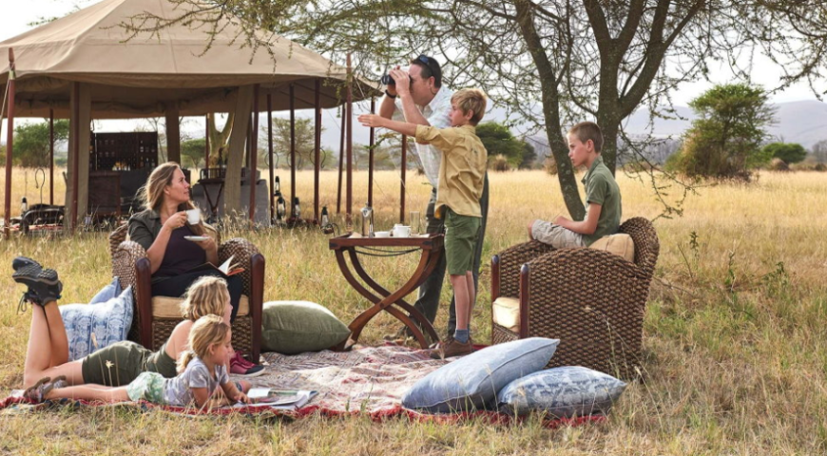
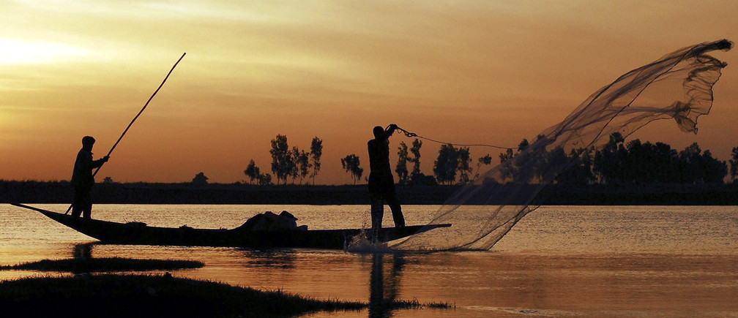
Africa is a continent that has a lot to offer. Our excursions include nature hikes, camping, fishing and getting close to wildlife while practicing safety precautions.
Hiking
Camping
Fishing
Photos taken from https://Vertuoso.com/
Photos taken from https://www.bigskysafaris.com/
Photos taken from https://www.weforum.org/

Slide 28


Asia
Asia is full of big cities, beautiful nature, culture and architecture. Our excursions in Asia includes different countries worth visiting such as China, Thailand and Japan. Our trips were designed to experience the best out of this continent including unique landmarks, food experiences, and mountain hikes.
Photos taken from https://Shutterstock.com/
Photos taken from https://iStock.com/

Slide 29


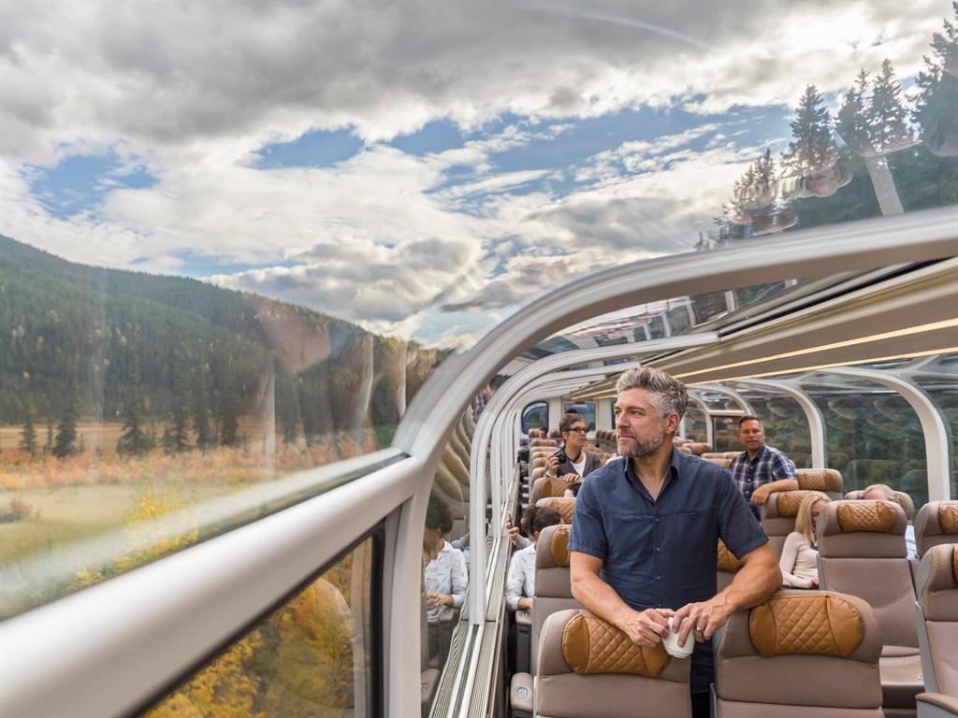
North America
North America has a very unique and diverse environment. Our excursions include riding a train through the mountains in Montana, hiking through the Cascade Mountains, visiting Yosemite and hiking near the Golden Gate bridge. This excursion is perfect for those who are mountain lovers!
Photos taken from https://travel.gc.ca/canadian-tourism?
Photos taken from https://amazon.com/
Photos taken from https://www.insightvacations.com/

Slide 30


South America
South America offers the best of a tropical mountain and beach experience. Our excursions in South America includes great food, mountain hikes to popular landmarks in Peru and relaxation by the beaches of Brazil.
Photos taken from https://www.southamerica.travel/brazil/travel-info/best-time-to-visit
Photos taken from https://www.latintoursinc.com/

Slide 31
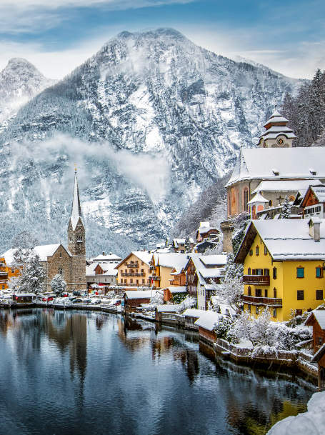
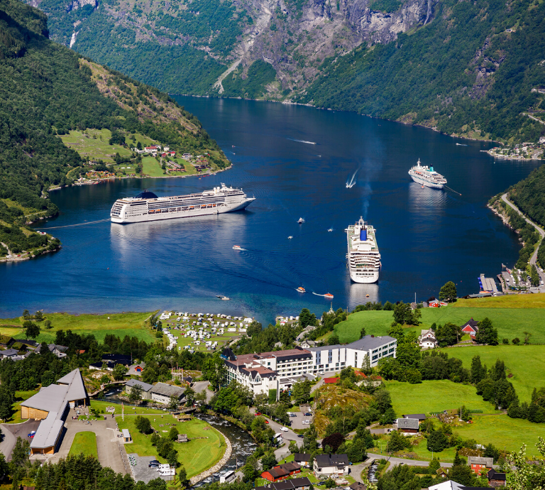
Northern Europe
Northern Europe has a lot of charm, and offers an unlimited amount of experiences. In our excursions we included visits to the Alpine Lakes in Norway, historical charming towns in Ireland, mountain hikes, and to top it off a very unique food and cultural experience.
Photos taken from https://glcruises.com/
Photos taken from https://Vermo.com/

Slide 32
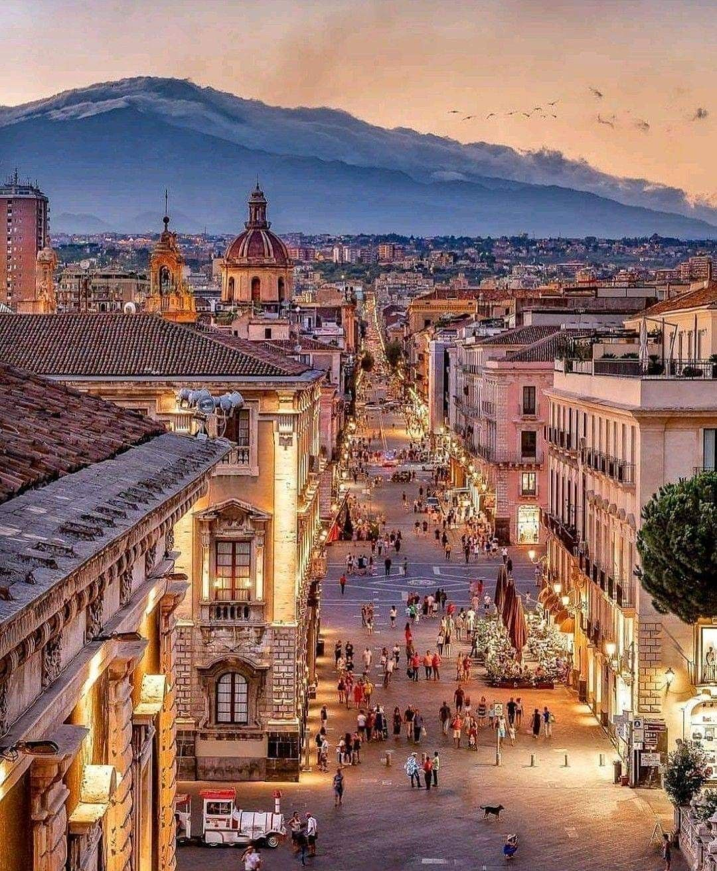

Southern Europe Southern Europe offers mesmerizing historical landmarks. Our Excursions include exploring Italy’s charming towns, wineries, unique hikes in France, and beach towns in Greece.
Photos taken from https://pixers.co.nz/
Photos taken from https://pinterest.com/

Slide 33
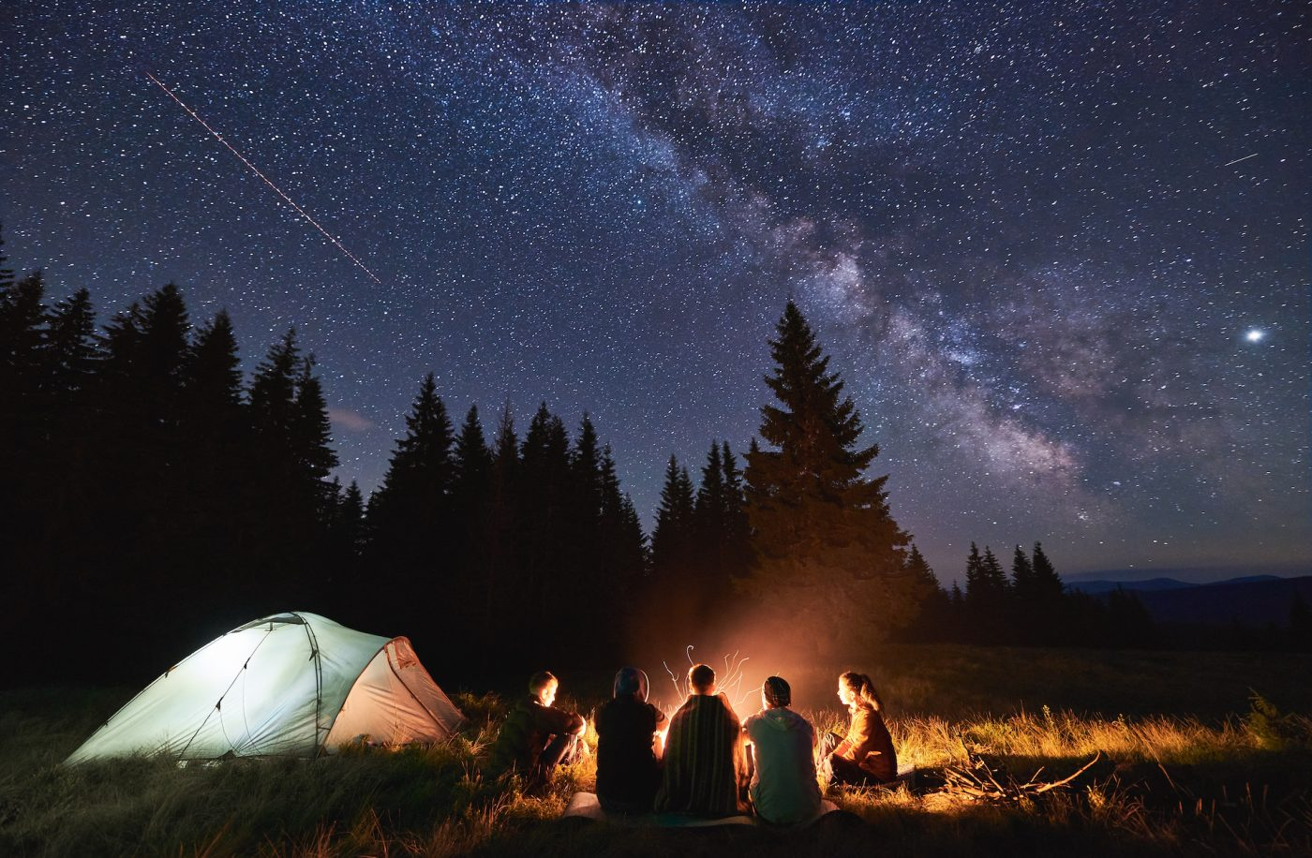
Assumptions:
Owners are considered in the employee table.
Each destination has its own flat airline fee.
Only new equipment is purchased to sell or rent but the owners brought new equipment to the business which can be several years old.
Card number represents payment information customer would provide.
Every customer and employee on a trip is going on all excursions.
Items include equipment, supplies, and safety essentials.
Full inventory reports or available items reports were not create for this case study
Camping is part of the excursion activities.
If customer_order table shows “is_rental” field as “0” or “false”, customer decided to buy equipment.
Photos taken from https://travelawaits.com/

Slide 34

Each excursion will be documented per day (If excursion takes multiple days, it will be listed once per day).
Each of the Guides will be required to have each of the items required for the trip.
If a trip requires an item, only one person will be required to check out the item.
The project does not provide interactive website reports for customers to check trip schedules. or purchase equipment. There is an interactive report to show equipment over X years old.
All trips are assumed to be paid for so there is no invoice or billing information provided in this report.
The business has expanded since this case study was written to conduct trips in North America, Northern Europe, and South America
Customer inoculation records were updated while evaluating this case study. Customers provided additional information since the tables were originally created.
Photos taken from https://pinterest.com/

Slide 35
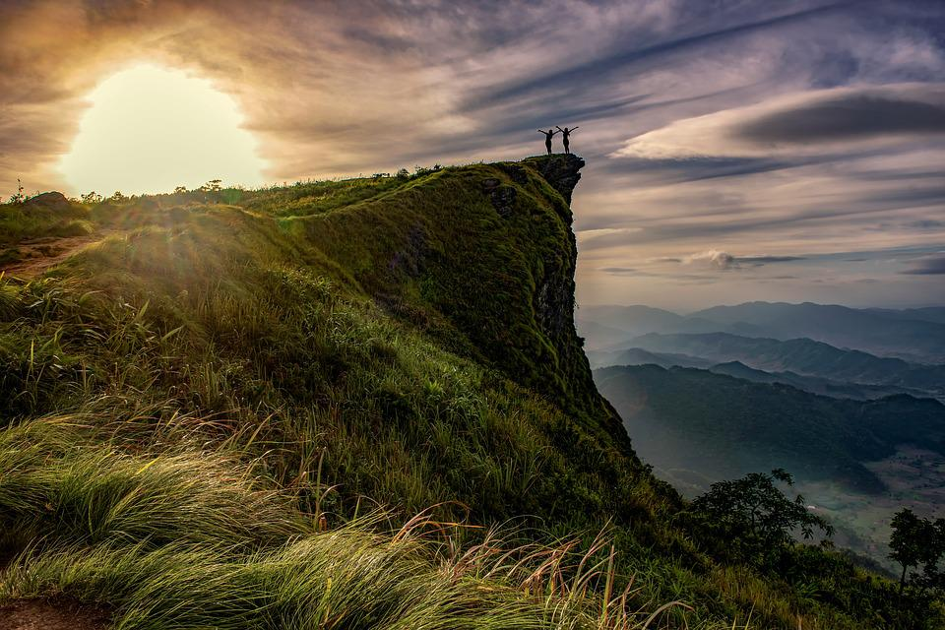
Thank You
The Outlanders Team
Team Members:
Chris Beatty - https://github.com/AnotherByte/csd-310.git
Brian Gossett - https://github.com/BrianGossett/csd-310.git
Larissa Passamani Lima - https://github.com/passamani15/csd-310.git
Christeen Safar - https://github.com/ChristeenS/csd-310.git
Michele Speidel - https://github.com/jamdmmsfreese/csd-310.git
N/A. (n.d.). Hiking Clipart. Clipart Panda.
Retrieved July 9, 2022, from
http://images.clipartpanda.com/hiking-clipart-hike.gif
Backgrounds taken from https://www.googleimagesearch.com/

Slide 36
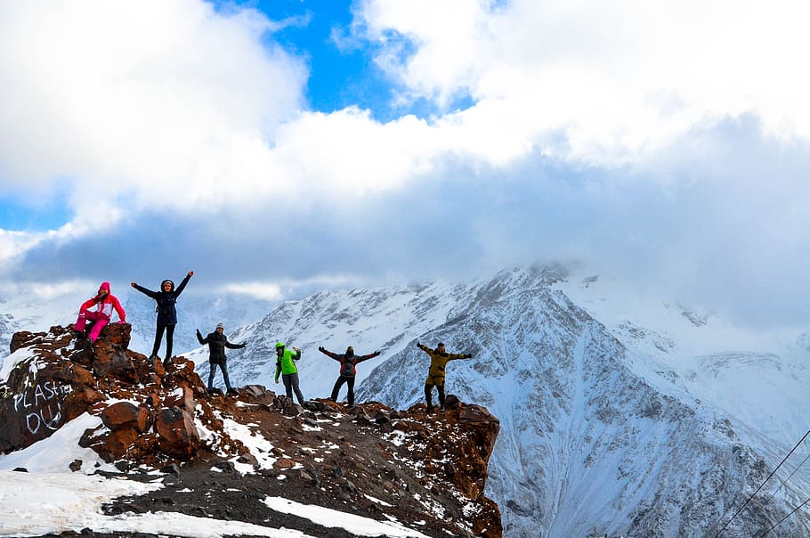
For the full Case Study, refer to Appendix A attached
Backgrounds taken from https://www.googleimagesearch.com/

